Slide 1

Using Data Mining Techniques To Predict the Rugby World Cup 2023 Winner
Logan Roach

Slide 2

Outline
Why Should We Care?
About the Data
Cleaning and Organizing the Data
Association Rules For Winning
Naïve Bayes Classifying Winning Teams
Selecting Winners Using Decision Tress
Summary of the Results
Notes:
WRC happens every 4 years
Why Should We Care?
About the Data (an overview and a sample visualization)_
Cleaning and Organizing the Data
Association Rules For Winning
Selecting Winners Using Decision Tress
Naïve Bayes Classifying Winning Teams (using home and away results)
Summary of the Results (Predictions and Conclusions)

Slide 3
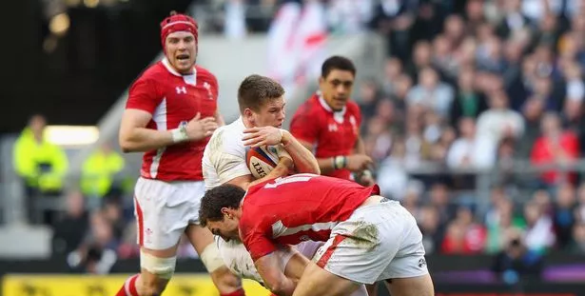

Why Should We Care?
Consider The Economic Impact of the Sport and Hosting The World Cup
The host nation receives a direct economic stimulus (at least £610m for the Host Nation and up to £2.1 billion for surrounding territories in Europe for 2023)
The Rugby World Cup is the third largest sporting event in the world
The winners receive a monetary prize and get an injection of exposure for both the country and program
Notes:
There’s a large economic impact of large sports tournaments

Slide 4

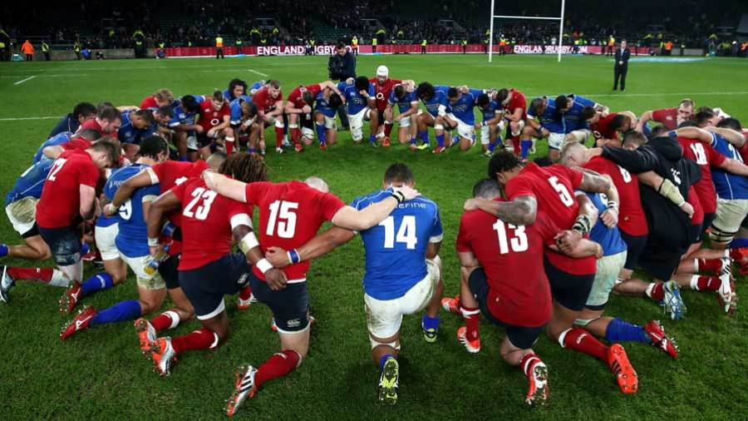
Why Should We Care?
International Sports are a Common Venue for Strengthening Global Ties and Unity
International games like the Olympics and the FIFA World Cup give the opportunity for friendly competition and cultural exchange
Each participating country gets an elevation in their profile allowing for future benefits in economic and global relations
Rugby is known for its inclusivity and celebratory culture making it an ideal vector for embracing cultural exchange between countries
Rugby is the fastest growing sport in the United states with expressed interest in hosting the 2031 Men’s Rugby World Cup and the 2033 Women’s Rugby World Cup
Notes:
International Sports are a great venue for promoting unity

Slide 5
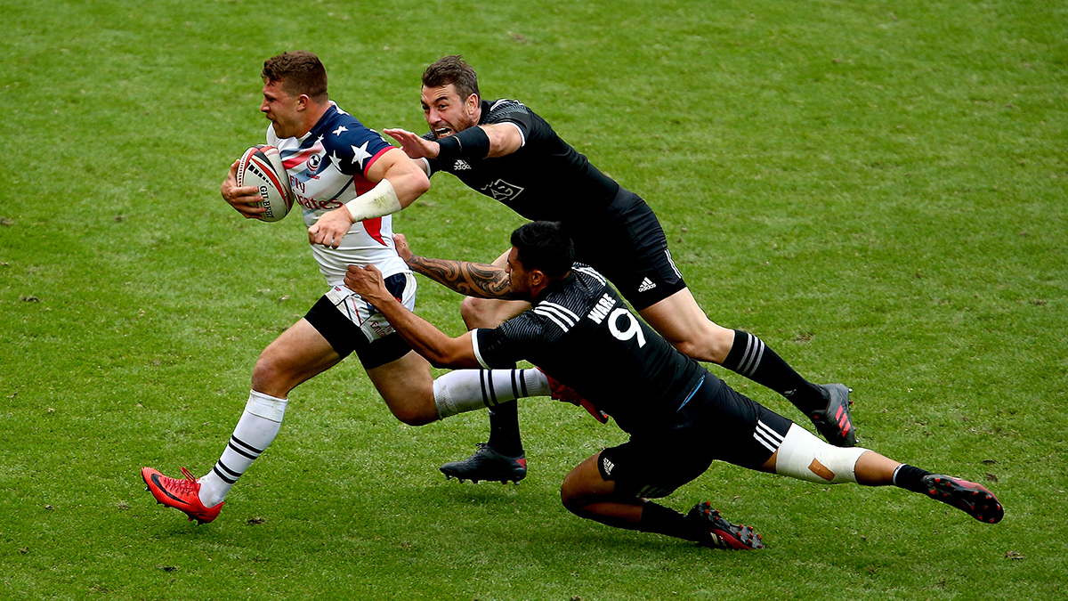

Why Should We Care?
Rugby is Quite Possibly the Most Entertaining and Physically Impressive Sport in the World
Imagine combining the best parts of football, soccer, and wrestling into one sport with the same physical demands and spectacle
Rugby > American Football (Most Popular Sport)
Examples: Top Ten Scores From Previous World Cups
https://www.youtube.com/watch?v=dexpn0Vv7a4
Notes:
Rugby is the best sport in the world

Slide 6
About the Data
Data Source: https://www.kaggle.com/datasets/lylebegbie/international-rugby-union-results-from-18712022/code
Size of the Data Frame:
2727 observations (rows) and 11 variables (columns)
The records go back to 1871 and go to 2023
Notes:
Data from Kaggle
Size of the Data Frame:
2727 observations (rows) and 11 variables (columns)
The records go back to 1871 and go to 2023

Slide 7
A Sample Visualization
Original Columns:
Date – Day of Rugby Game (YYYY-MM-DD)
Home Team
Away Team
Home Score
Away Score
Competition – Tournament or Friendly Game
Stadium – Venue of the Rugby Game
City
Country
Neutral (True/False)
World Cup (True/False)
date | home_team | away_team | home_score | away_score | competition | stadium | city | country | neutral | world_cup
1871-03-27 | Scotland | England | 1 | 0 | 1871 Scotland v England International | Raeburn Place | Edinburgh | Scotland | FALSE | FALSE
1872-02-05 | England | Scotland | 2 | 1 | 1871-72 Home Nations International | The Oval | London | England | FALSE | FALSE
1873-03-03 | Scotland | England | 0 | 0 | 1872-73 Home Nations International | West of Scotland F.C. | Glasgow | Scotland | FALSE | FALSE
1874-02-23 | England | Scotland | 1 | 0 | 1873-74 Home Nations International | The Oval | London | England | FALSE | FALSE
1875-02-15 | England | Ireland | 2 | 0 | 1874-75 Home Nations rugby union matches | The Oval | London | England | FALSE | FALSE
Notes:
First 5 rows of the initial data frame
Begins in 1871
Original Columns:
Date – Day of Rugby Game (YYYY-MM-DD)
Home Team
Away Team
Home Score
Away Score
Competition – Tournament or Friendly Game
Stadium – Venue of the Rugby Game
City
Country
Neutral (True/False)
World Cup (True/False)

Slide 8
Cleaning and Organizing the Data
winning_side | winning_team | outcome
home | Scotland | Scotland-home
home | England | England-home
draw | draw | draw-draw
home | England | England-home
home | England | England-home
Initially cleaned the data and noticed NA values were in the competition column as they were “friendly matches” and not part of any formal competition
Added 3 new columns
Winning_side: used the home_team, away_team, home_score, and away_score to determine which team won (home or away)
Winning_team: used the same columns as before to identify the team that won
Outcome: A combination of the winning side and winning team columns for a concise summary of the game’s outcome
Notes:
Initially cleaned the data and noticed missing values were in the competition column as they were “friendly matches” and not part of any formal competition
Added 3 new columns
Winning_side: used the home_team, away_team, home_score, and away_score to determine which team won (home or away)
Winning_team: used the same columns as before to identify the team that won
Outcome: A combination of the winning side and winning team columns for a concise summary of the game’s outcome
Simple visualization on the right

Slide 9
One More Addition
Another numerical column was added to the data matrix for use later in the analysis
This was done by taking the difference between the winning and losing scores in the data
home_score | away_score | outcome | winning_margin
19 | 12 | Ireland-home | 7
42 | 0 | Wales-home | 42
24 | 17 | France-home | 7
6 | 13 | England-away | 7
24 | 14 | Ireland-home | 10
Notes:
One more addition was added to the data, another numerical column that takes the difference between the home_ and away scores

Slide 10
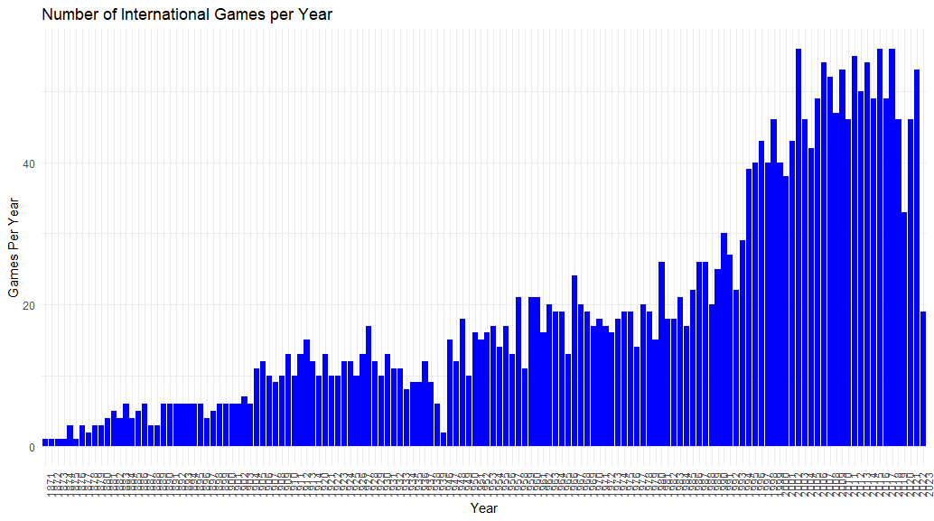
Distribution of Rugby Games Across Recorded History
Notes:
Here is a distribution of games throughout history, as we can see there is a slow start in the late 1800’s and early 1900’s and ramp up later in time
I think that’s important as we will see soon

Slide 11
Distribution of Rugby Games Across Recorded History
Notes:
PULKLING BACK
Something I noticed when preforming this analysis is that a lot of the data is Left Skewed, with most of the matches played within the later half of the 20th century and this century.
Click
Instead of focusing on all historical data, if we focus on only the most recent data as it is the most relevant
Why? -> next slide

Slide 12
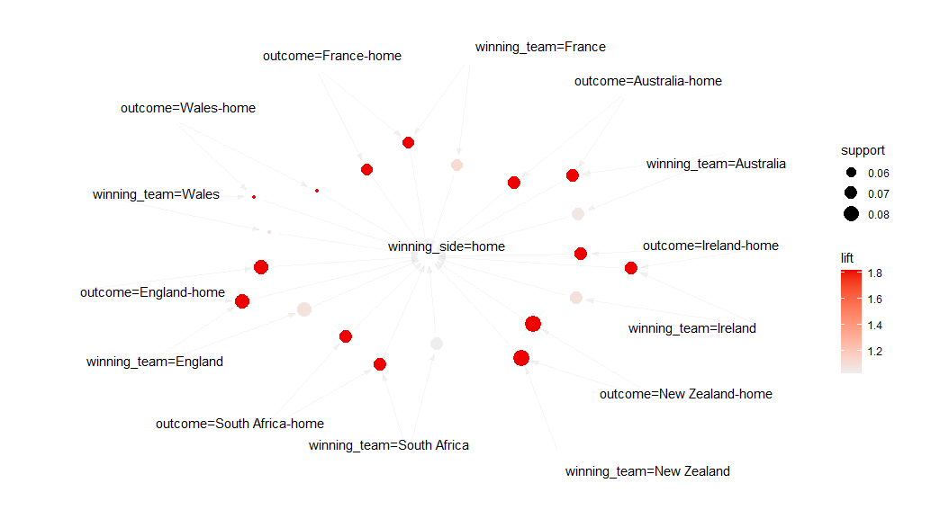
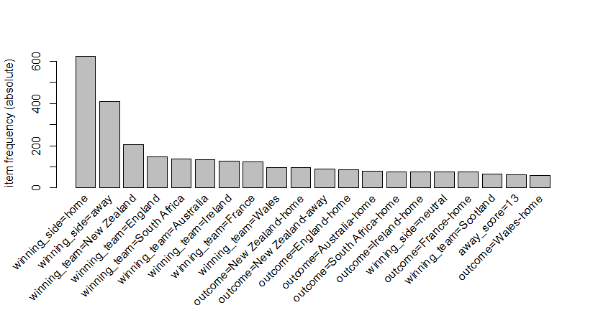
Association Rules For Winning Since 2000
The following rules for a team to win using data since 2000:
Teams playing at Home had more wins than teams playing Away from Home
The Teams with most wins were found to be New Zealand, England, South Africa and then Australia
Notes:
The following rules for a team to win using data since 2000:
Teams playing at Home had more wins than teams playing Away from Home
The Teams with most wins were found to be New Zealand, England, South Africa and then Australia

Slide 13
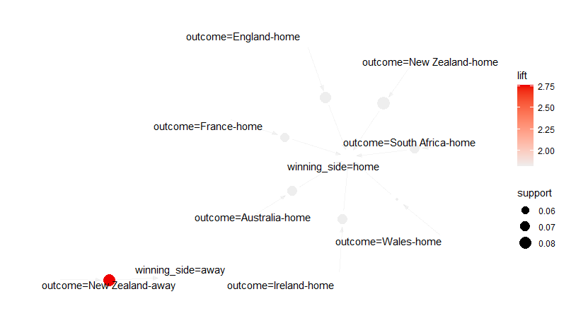
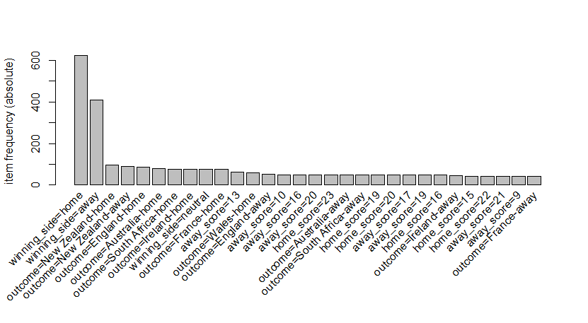
Performing Well Away?
Another Analysis using Association Rule Mining was done to see if there were any teams that performed well away
It was found that New Zealand stood out as winning away from home almost as much as at home
Notes:
Another Analysis using Association Rule Mining was done to see if there were any teams that performed well away
It was found that New Zealand stood out as winning away from home almost as much as at home

Slide 14
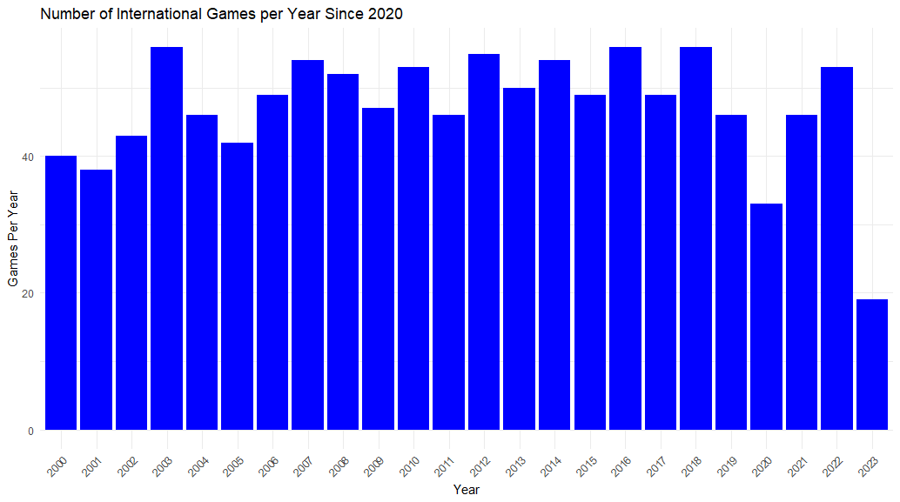
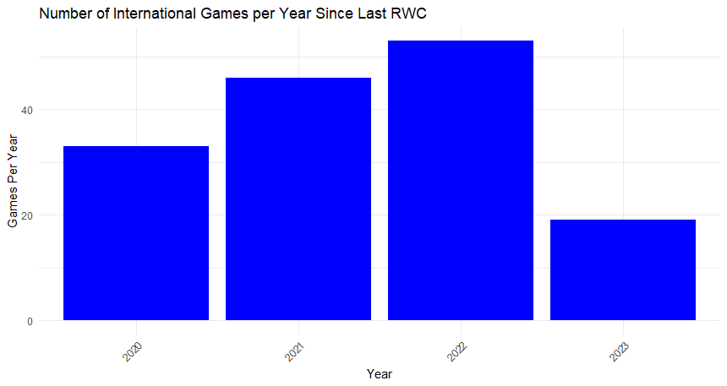
Rugby Today
For sports the most relevant data for predicting the outcome of games today is the most recent data
Focusing in on data in just this century scales down the data
Going further, focusing on data since the last RWC will narrow the scope to the most relevant data
Notes:
For sports the most relevant data for predicting the outcome of games today is the most recent data
why?
Rule changes, Most Effective Tactics Available (META) changes,
The teams are comprised of the top performing CURRENT players
Focusing in on data in just this century scales down the data
Going further, focusing on data since the last RWC will narrow the scope to the most relevant data
Significantly reduced the data from 2727 games
NOW HAVE 151 games in the data for predicting the winner

Slide 15
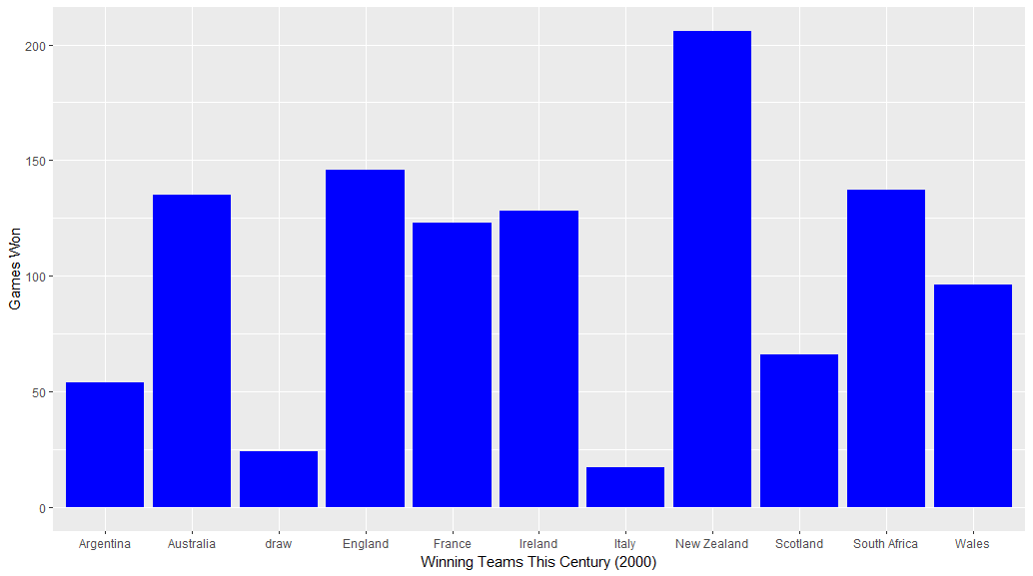
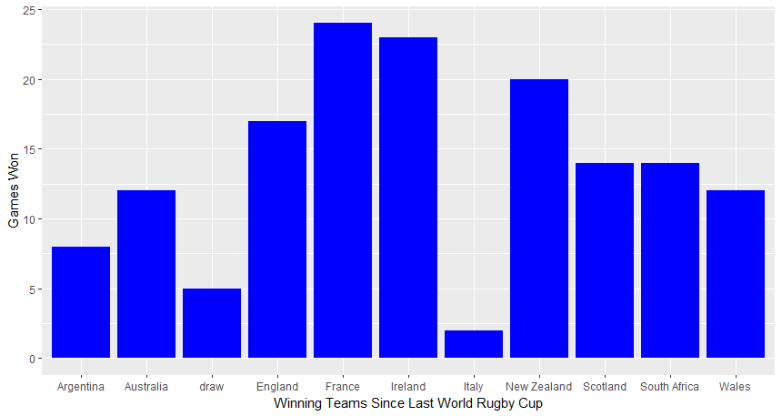
Rugby Today
The importance of focusing on the most relevant data can be seen by comparing team wining records since 2000 and since the last Rugby World Cup
Notes:
We can see the importance of focusing on the most relevant data by comparing team wining records since 2000 and since the last Rugby World Cup
France and Ireland (our top performers right) can contribute most of their wins since 2000 to their recent successes
New Zealand performance comes from wins since the turn of the century, less successful in the past 4 years
GOING FORWARD, only using data since the previous world cup

Slide 16
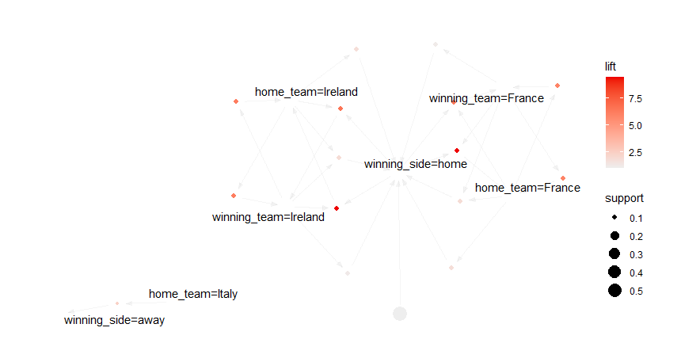
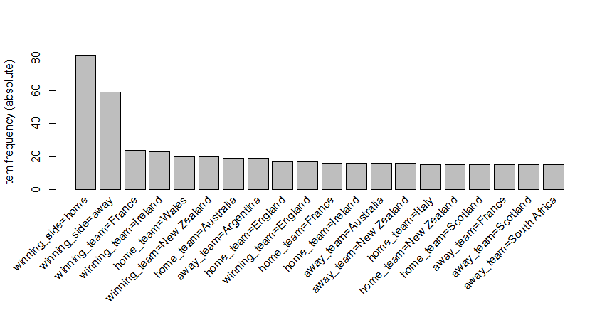
Association Rule Mining With Recent Data
Here Association Rule Mining shows us that even in recent years the home team has the advantage
These days, the top performing team is France closely followed by Ireland
Notes:
USING DATA SINCE THE LAST WORLD RUGBY CUP
Here Association Rule Mining shows us that even in recent years the home team has the advantage
These days, the top performing team is France closely followed by Ireland
The one outlier is even when Italy is playing at home the away team seems to win
Can contribute this to Italy’s poor performance

Slide 17
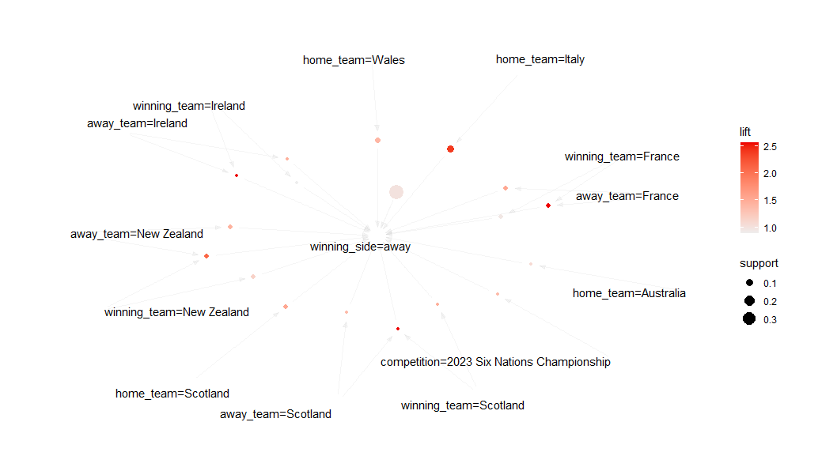
Association Rule Mining With Recent Data – Who Wins Away From Home?
Had to reduce the support and confidence parameters to find rules because the home advantage is so prevalent
Notes:
Had to reduce the support and confidence parameters so we can take these results with a grain of salt
Teams Beat Italy when Italy is at home, makes since Italy is the worst performer in the data
New Zealand and France perform better away with Ireland being a close third
Had to reduce the support (0.05) and confidence (0.01) parameters to find rules

Slide 18
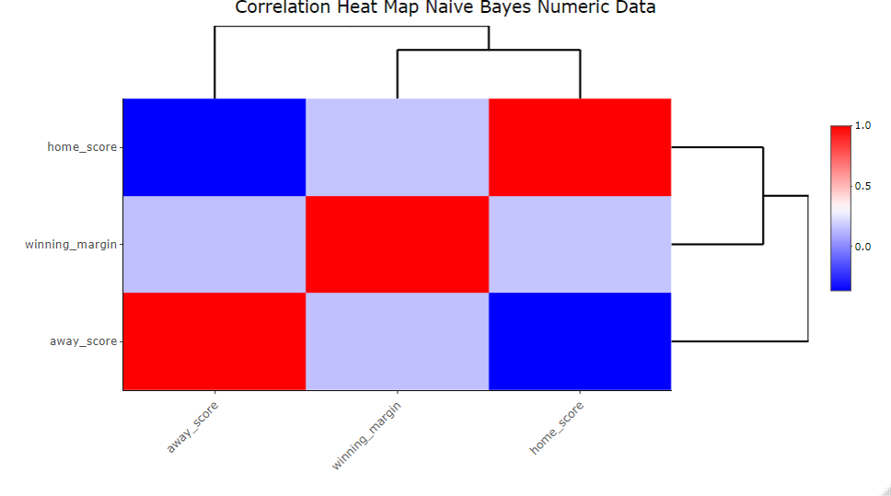
Naïve Bayes Classification – Preparing the Data
Modified the game data since the previous RWC to a data frame containing the columns visualized below (151 observations of 6 variables)
The data was split into a training set and testing set like before
Training set contained 66% of the data with the remaining going into the test set
winning_team | home_team | away_team | home_score | away_score | winning_margin
Ireland | Ireland | Scotland | 19 | 12 | 7
Wales | Wales | Italy | 42 | 0 | 42
France | France | England | 24 | 17 | 7
England | Scotland | England | 6 | 13 | 7
Ireland | Ireland | Wales | 24 | 14 | 10
Notes:
Can we predict the winning team using the home and away records of teams?
Modified the game data since the previous RWC to a data frame containing the columns visualized below (151 observations of 6 variables)
The data was split into a training set and testing set like before
Training set contained 66% of the data with the remaining going into the test set
Naïve bayes assumes no correlation between the data which we can see in the correlation heat map to the left here, only the slightest bit seen in the some of the numbers but none really above 0.5

Slide 19
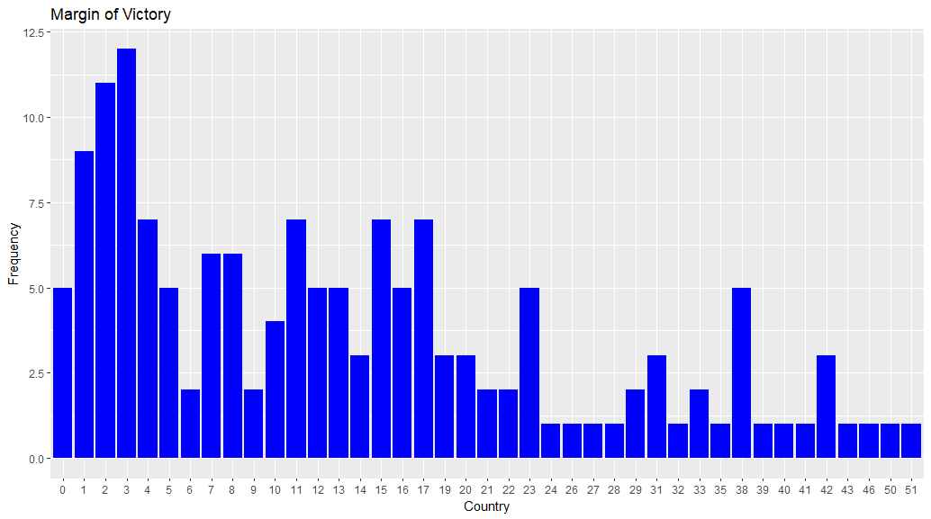
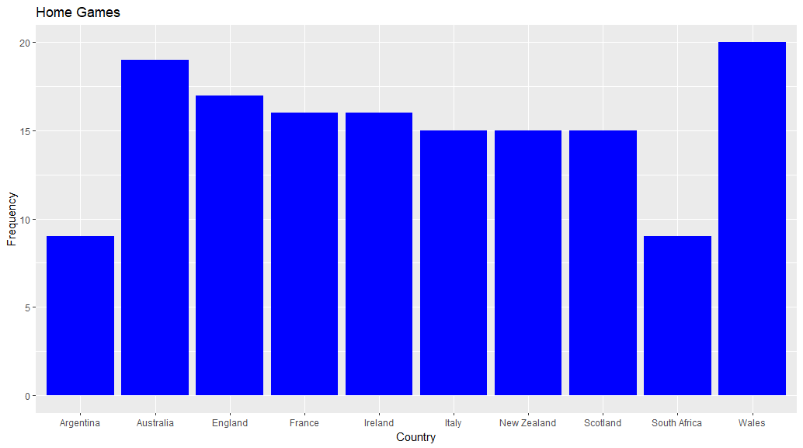
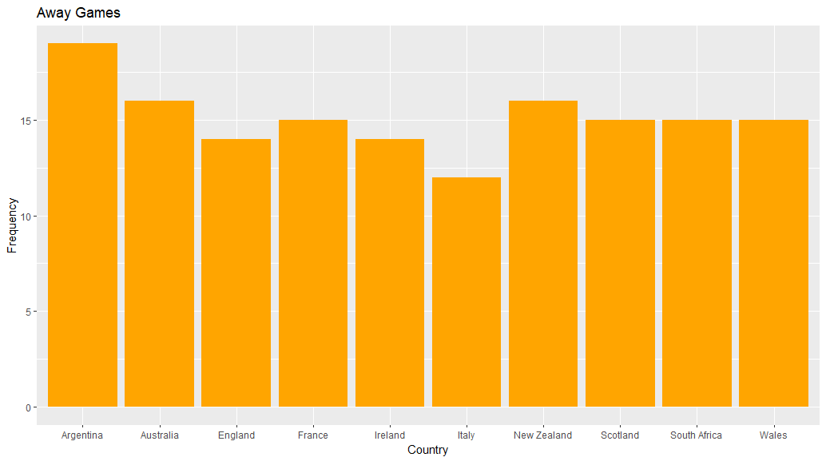
Variable Frequency in the Data
Notes:
Frequency Plots of the data in the Naïve bayes modeling
1 Point difference in the matches, (skewed to closer matches)
France and Ireland have the most games won, followed by New Zealand
Wales had the most home games followed by Australia
Argentina had the most away games followed closely by Australia and new zealand

Slide 20
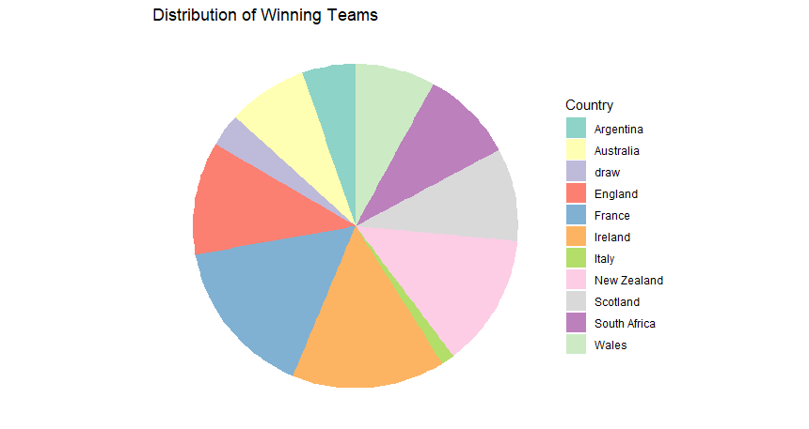
Naïve Bayes Classification - Results
The initial results of the Naïve Bayes model showed an accuracy of 53.33% when trying to predict the winning team
Incorporating Laplace smoothing improved the model to have an accuracy of 60%
To try and improve the model’s accuracy, 10-fold cross validation was performed where the Laplace value was sequenced from 0.1 to 1.0 by 0.1
The cross-validation model using the best tunning parameters returned an accuracy of 48.89%
Notes:
The initial results of the Naïve Bayes model showed an accuracy of 53.33% when trying to predict the winning team when using data
Such as who the home team is, the away team, the scores for each team and the point difference.
“LA-PLACE”
It was also found that setting the laplace value to 1 improved the model to have an accuracy of 60%
To try and improve the model’s accuracy, 10-fold cross validation was performed where the laplace value was sequence from 0.1 to 1.0 by 0.1 to try and find the optimal value
The cross-validation model using the best tunning parameters returned the same accuracy (53.33%), so I may have to go back and see if I can improve the model
As it stands, the model could predict the winning team 53.33% of the time, if I had more information like the number of penalties, yellow or red cards, or other
Match information, the model could be improved

Slide 21
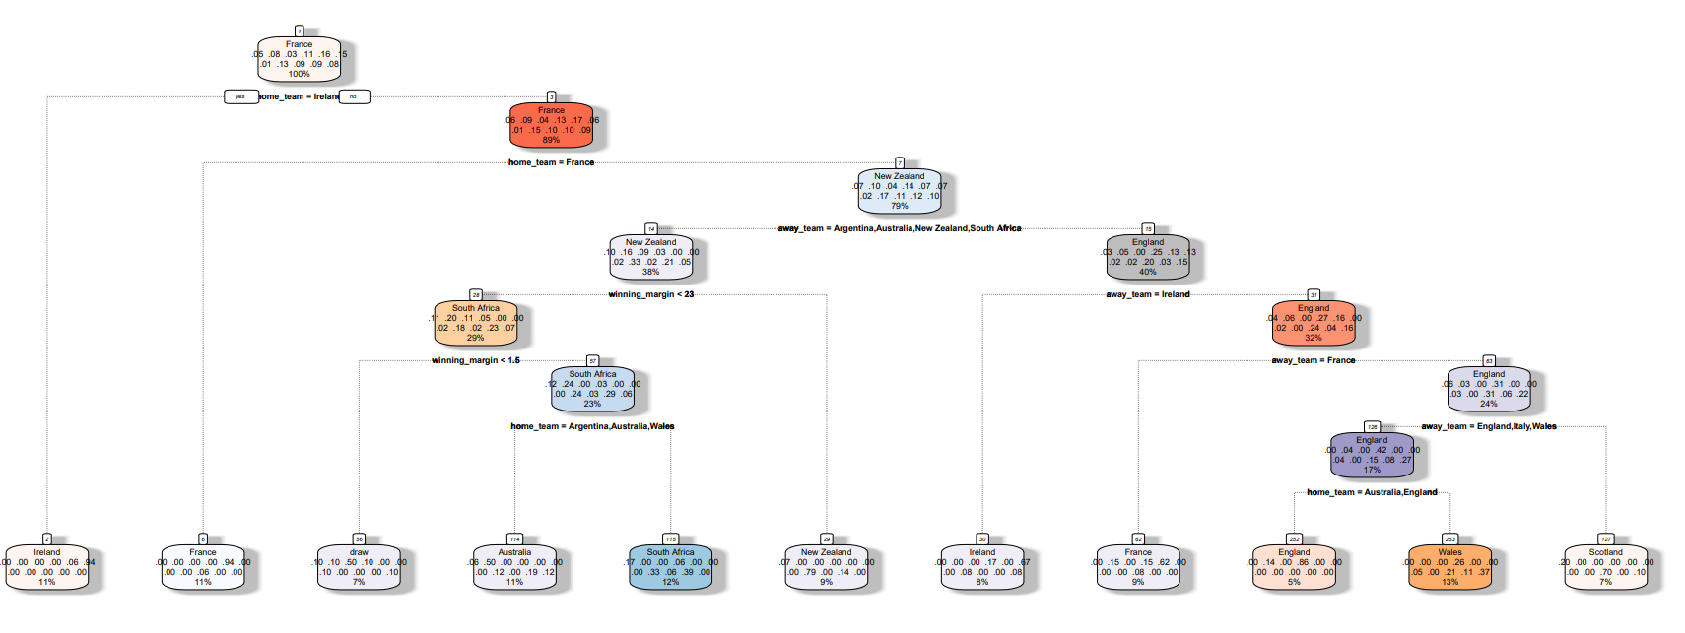
Decision Trees – Who Wins?
Decision Criteria:
Target variable = winning_team
Deciding Data Features = winning_margin, winning_side, home_team, away_team, home_score, away_score
The data was split using a training set of 66% of the data and a testing set of the remaining third of the data set
Notes:
Decision Criteria:
Target variable = winning_team
Deciding Data Features = winning_margin, winning_side, home_team, away_team, home_score, away_score
The data was split using a training set of 66% of the data and a testing set of the remaining third of the data set
151 samples
6 predictor
11 classes: 'Argentina', 'Australia', 'draw', 'England', 'France', 'Ireland', 'Italy', 'New Zealand', 'Scotland', 'South Africa', 'Wales’
Chose winning team as the target variable as its what we are trying to predict

Slide 22
Decision Trees – Who Wins?
Using data since the last Rugby World Cup:
France has the best winning record giving us the root node to start
The branches in the tree determine the opposition (home/away)
Nodes are the winners from the previous node using the branching criteria
Terminal Nodes (Leaves) show the final decision
The overall accuracy of the decision tree model was 48.9%
Notes:
Using data since the last Rugby World Cup:
France has the best winning record giving us the root node to start
The branches in the tree determine the opposition (home/away) YES = LEFT, NO = RIGHT
Nodes are the winners from the previous node using the branching criteria
Terminal Nodes (Leaves) show the final decision
The overall accuracy of the decision tree model was 48.9%
LOOKS TO BE SOME OVERFITTING OF THE DATA (BOTTOM RIGHT)
France at home winning 11% of the time and France away winning 9% of the time giving a combined 20% winning percentage in the data
Ireland winning 11% (against France at home) and Ireland winning 8% away from home for a combined 19% winning percentage the data model
Wales winning 13% from the data model
South Africa winning 12% from the data model
Australia wiining 11% from the model

Slide 23
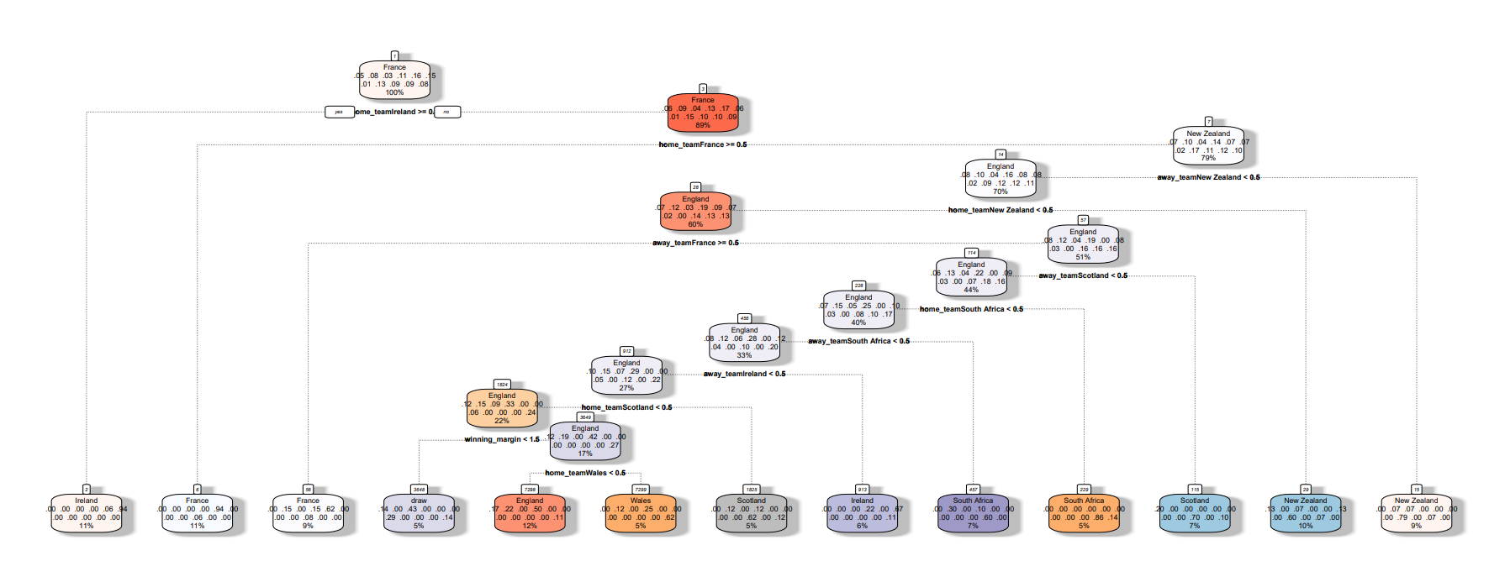
Decision Trees Can We Improve The Model?
To improve the model a 10-fold cross validation was performed where the ideal complexity parameter (cp) was determined along a sequence from 0.01 to 0.1 increasing by 0.01
Notes:
To improve the model a 10-fold cross validation was performed where the ideal complexity parameter (cp) was determined along a sequence from 0.01 to 0.1 increasing by 0.01
Cp = complexity parameter = hyperparameter that controls the trade-off between tree complexity and accuracy during pruning
It represents the cost that is assigned to adding a new node to the tree
Cost complexity pruning used to mitigate overfitting, smaller cp = more aggressive pruning (we want to improve the accuracy of the model)
cost-complexity algorithm assigns a cost to each node in the tree based on factors like misclassification rate
The goal is to find the right balance between tree complexity and predictive accuracy.

Slide 24
Decision Trees Can We Improve The Model?
The optimal complexity parameter was found to be 0.02 increasing the model accuracy to 57.03%
Again, we see France as the top predicted winner (France is also hosting the Rugby World Cup this year)
Notes:
The optimal complexity parameter was found to be 0.02 increasing the model accuracy to 57.03%
Again, we see France as the top predicted winner (France is also hosting the Rugby World Cup this year)
France still has the highest winning percentage (11% + 9%) =20%
New Zealand comes 2nd with a (10% + 9%) combined 19% winning percentage
Ireland is 3rd with a (11% + 6%) 17% combined winning percentage
SA and Scotland have a combine winning percentage of 12%
England has a 12% winning percentage
Wales has a 5%
Draw = 5%

Slide 25
Summary
France and Ireland are the top performing teams since the last Rugby World Cup
The home team has a significant advantage to win
Since 2000, New Zealand has had the best record for winning away, that has shifted to France and Ireland performing the best when away from home
The Naïve Bayes Model shows there’s about a 50% accuracy in predicting winners using home/away match results
According to the Decision Tree Modeling: France, New Zealand, and Ireland had the highest win percentage in the leaf nodes of the pruned tree
France is hosting the current Rugby World Cup (2023)
Notes:
France and Ireland are the top performing teams since the last Rugby World Cup
The home team has a significant advantage to win
Traditionally New Zealand has had the best record for winning away, that has shifted to France and Ireland performing the best when away from home
According to the Decision Tree Modeling: France and Ireland had the highest win percentage in the leaf nodes of the tree
The Naïve Bayes Model shows there’s about a 50% accuracy in predicting winners using home/away match results
France is hosting the current Rugby World Cup (2023)

Slide 26
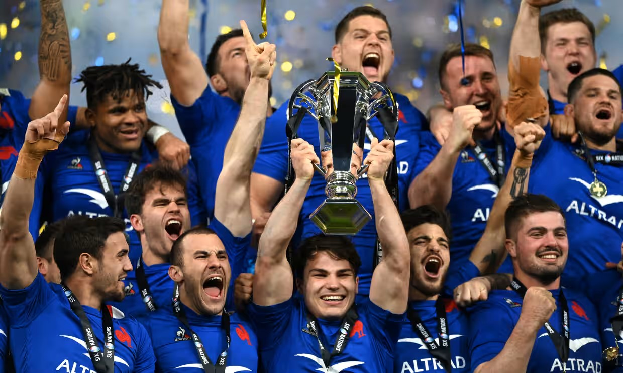
Conclusions and Predictions
France has been the top performing international rugby team and has home advantage across the nation as the 2023 Rugby World Cup host nation
Ireland, while also being a top performer, does not have the home advantage and is just edged out from taking first place by France
Notes:
France has been the top performing international rugby team and has home advantage across the nation as the 2023 Rugby World Cup host nation
Ireland, while also being a top performer, does not have the home advantage and is just edged out from taking first place by France
If I had access to more data from the matches such as penalties conceded, yellow and red card rates, starting squad injuries, and categorical and numerical data I could improve the models and make more certain predictions, which has been a weakness of this analysis

Slide 27
Thank you
Questions?

